Slide 1

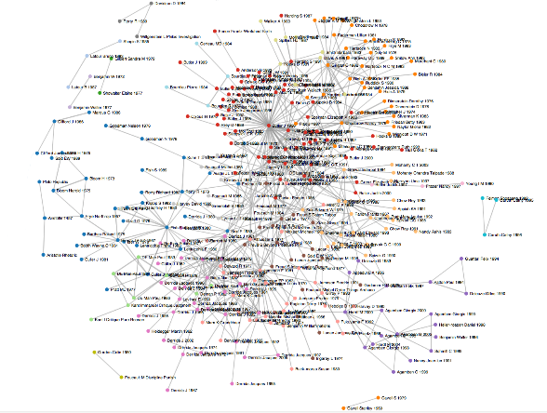
Reviewing the literature
St Cross: Thesis and Dissertation Writing

Slide 2
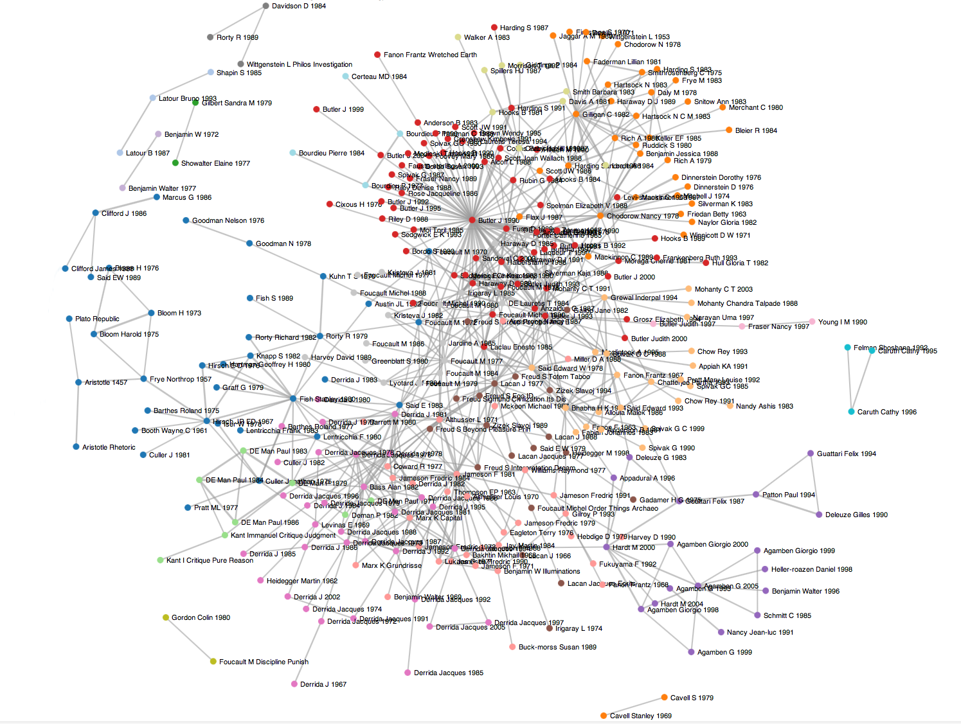

Slide 3
Overview of a thesis/dissertation

Slide 4
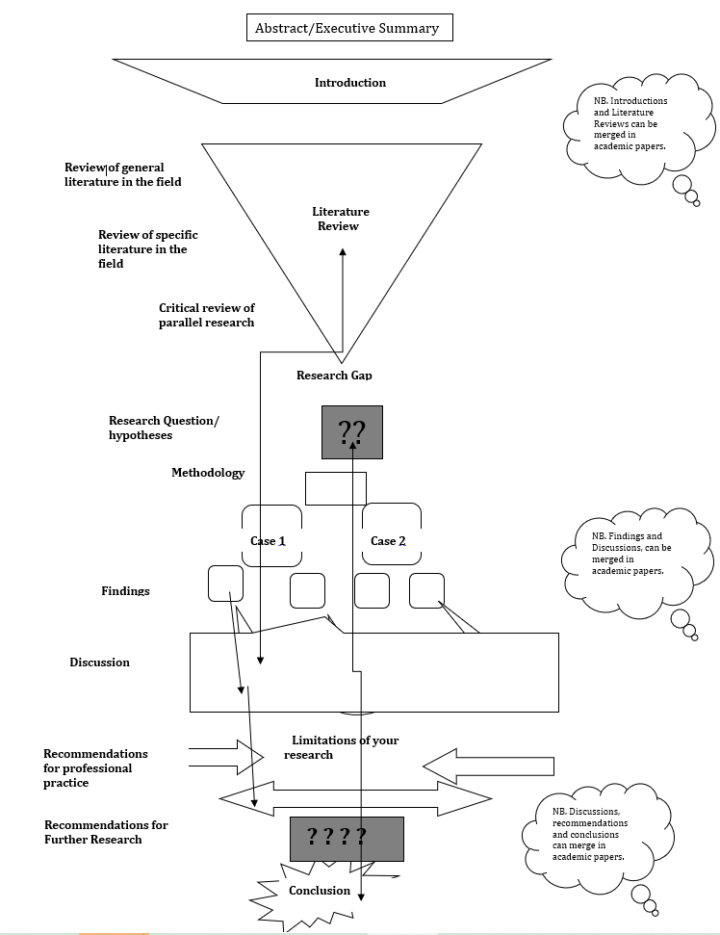

Slide 5
Literature review

Slide 6
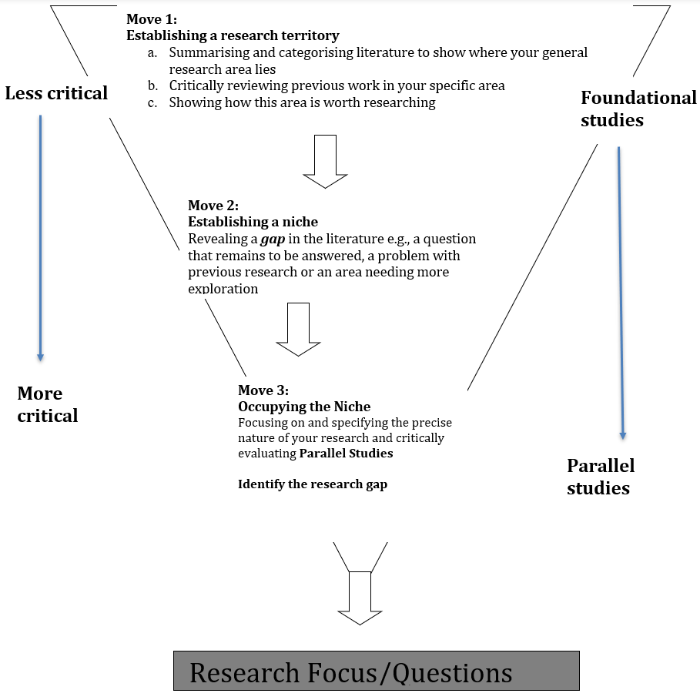

Slide 7
What’s the difference?
Writer 1:
“There appear to be three major causes of poverty in the area.”
Writer 2:
“There are three main causes of poverty in the area (Tanaka, 2012).”
Writer 3:
“Tanaka (2012) identified three major causes of poverty in the area.”
Writer 4:
“Numerous studies have identified the same major three causes of poverty in the area (Tanaka, 2012; Wu, 2013; Adeoye, 2020).”

Slide 8
Integral or Non-integral citations
“Work-home culture is defined as the assumptions, beliefs and values among organizational members regarding the extent to which an organization supports and values the integration of employees’ work and personal lives (Thompson, Beauvais and Lyness, 1999).”
“Thompson and Prottas (2005) showed that a supportive work-home culture was linked to lower levels of employee stress and depressive symptoms …”

Slide 9
Integral or Non-integral citations
Writer 1:
“There appear to be three major causes of poverty in the area.”
Writer 2:
“There are three main causes of poverty in the area (Tanaka, 2012).”
Writer 3:
“Tanaka (2012) identified three major causes of poverty in the area.”
Writer 4:
“Numerous studies have identified the same major three causes of poverty in the area (Tanaka, 2012; Wu, 2013; Adeoye, 2020).”

Slide 10
Focus on claims/facts
The tendency towards longer working hours for much of the labour force in the UK and North America (Brannen, 2000; Duxbury and Higgins, 2001), along with escalating numbers of dual-income families and employed single parents (Office for National Statistics, 2007), creates increasing opportunities for multiple roles to clash with one another. The negative effects of such interference between work and home have been well-documented, and include both organizational repercussions such as increased absenteeism and decreased job performance (Anderson, Coffey, and Byerly, 2002; Frone, Yardley, and Markel, 1997), and individual outcomes such as reduced life satisfaction and increased physical and psychological strain (Ford, Heinen, and Langkamer, 2007; Hammer, Saksvik, Nytrø, Torvatn, and Bayazit, 2004). The degree to which an organization’s culture exhibits support for its employees’ efforts to balance work and personal responsibilities can therefore be seen to be of paramount importance. Preoccupation with work when at home is one way in which work interference with home manifests (Greenhaus and Beutell,1985); this too may be reduced when the organizational work-home culture is supportive.
v

Slide 11
Focus on claims/facts
The tendency towards longer working hours for much of the labour force in the UK and North America (Brannen, 2000; Duxbury and Higgins, 2001), along with escalating numbers of dual-income families and employed single parents (Office for National Statistics, 2007), creates increasing opportunities for multiple roles to clash with one another. The negative effects of such interference between work and home have been well-documented, and include both organizational repercussions such as increased absenteeism and decreased job performance (Anderson, Coffey, and Byerly, 2002; Frone, Yardley, and Markel, 1997), and individual outcomes such as reduced life satisfaction and increased physical and psychological strain (Ford, Heinen, and Langkamer, 2007; Hammer, Saksvik, Nytrø, Torvatn, and Bayazit, 2004). The degree to which an organization’s culture exhibits support for its employees’ efforts to balance work and personal responsibilities can therefore be seen to be of paramount importance. Preoccupation with work when at home is one way in which work interference with home manifests (Greenhaus and Beutell,1985); this too may be reduced when the organizational work-home culture is supportive.

Slide 12
Focus on claims/facts
The tendency towards longer working hours for much of the labour force in the UK and North America (Brannen, 2000; Duxbury and Higgins, 2001), along with escalating numbers of dual-income families and employed single parents (Office for National Statistics, 2007), creates increasing opportunities for multiple roles to clash with one another. The negative effects of such interference between work and home have been well-documented, and include both organizational repercussions such as increased absenteeism and decreased job performance (Anderson, Coffey, and Byerly, 2002; Frone, Yardley, and Markel, 1997), and individual outcomes such as reduced life satisfaction and increased physical and psychological strain (Ford, Heinen, and Langkamer, 2007; Hammer, Saksvik, Nytrø, Torvatn, and Bayazit, 2004). The degree to which an organization’s culture exhibits support for its employees’ efforts to balance work and personal responsibilities can therefore be seen to be of paramount importance. Preoccupation with work when at home is one way in which work interference with home manifests (Greenhaus and Beutell,1985); this too may be reduced when the organizational work-home culture is supportive.

Slide 13
Focus on claims/facts
The tendency towards longer working hours for much of the labour force in the UK and North America (Brannen, 2000; Duxbury and Higgins, 2001), along with escalating numbers of dual-income families and employed single parents (Office for National Statistics, 2007), creates increasing opportunities for multiple roles to clash with one another. The negative effects of such interference between work and home have been well-documented, and include both organizational repercussions such as increased absenteeism and decreased job performance (Anderson, Coffey, and Byerly, 2002; Frone, Yardley, and Markel, 1997), and individual outcomes such as reduced life satisfaction and increased physical and psychological strain (Ford, Heinen, and Langkamer, 2007; Hammer, Saksvik, Nytrø, Torvatn, and Bayazit, 2004). The degree to which an organization’s culture exhibits support for its employees’ efforts to balance work and personal responsibilities can therefore be seen to be of paramount importance. Preoccupation with work when at home is one way in which work interference with home manifests (Greenhaus and Beutell,1985); this too may be reduced when the organizational work-home culture is supportive.

Slide 14
Focus on claims/facts
The tendency towards longer working hours for much of the labour force in the UK and North America (Brannen, 2000; Duxbury and Higgins, 2001), along with escalating numbers of dual-income families and employed single parents (Office for National Statistics, 2007), creates increasing opportunities for multiple roles to clash with one another. The negative effects of such interference between work and home have been well-documented, and include both organizational repercussions such as increased absenteeism and decreased job performance (Anderson, Coffey, and Byerly, 2002; Frone, Yardley, and Markel, 1997), and individual outcomes such as reduced life satisfaction and increased physical and psychological strain (Ford, Heinen, and Langkamer, 2007; Hammer, Saksvik, Nytrø, Torvatn, and Bayazit, 2004). The degree to which an organization’s culture exhibits support for its employees’ efforts to balance work and personal responsibilities can therefore be seen to be of paramount importance. Preoccupation with work when at home is one way in which work interference with home manifests (Greenhaus and Beutell,1985); this too may be reduced when the organizational work-home culture is supportive.

Slide 15
Focus on claims/facts
The tendency towards longer working hours for much of the labour force in the UK and North America (Brannen, 2000; Duxbury and Higgins, 2001), along with escalating numbers of dual-income families and employed single parents (Office for National Statistics, 2007), creates increasing opportunities for multiple roles to clash with one another. The negative effects of such interference between work and home have been well-documented, and include both organizational repercussions such as increased absenteeism and decreased job performance (Anderson, Coffey, and Byerly, 2002; Frone, Yardley, and Markel, 1997), and individual outcomes such as reduced life satisfaction and increased physical and psychological strain (Ford, Heinen, and Langkamer, 2007; Hammer, Saksvik, Nytrø, Torvatn, and Bayazit, 2004). The degree to which an organization’s culture exhibits support for its employees’ efforts to balance work and personal responsibilities can therefore be seen to be of paramount importance. Preoccupation with work when at home is one way in which work interference with home manifests (Greenhaus and Beutell,1985); this too may be reduced when the organizational work-home culture is supportive.

Slide 16
Focus on authors
Both Matsui, Ohsawa, and Onglatco (1995) and Nelson, Quick, Hitt, and Moesel (1990) found that work-home interference resulted in increased psychological strain only for the women in their samples. Beatty (1996) found a link between work interference with home and depression only for women with children. However, Parasuraman, Greenhaus, and Granrose (1992) uncovered an association between work-home interference and life stress that existed only for men.

Slide 17
Focus on authors
If you wish to focus on one source for several lines or a paragraph, this is not good:
Few technologies are intrinsically disruptive in character; rather, it is the business model that the technology enables that creates the disruptive impact (Christensen, 1997). Thus, evolution from a technological focus to a business-modelling focus is central to understanding the evolution of business at the market or industry level (Christensen, 1997). Disruptive innovations are usually not "advanced technologies": instead, they are often novel combinations of existing components, applied cleverly to a small, novel value network (Christensen, 1997).
Cooper, 2016
Avergou, 2015
Tanaka, 2014
Peterson, 2010

Slide 18
In this case, Christensen (1997) probably deserves his own paragraph, led by your own words in the form of a topic sentence:
If you wish to focus on one source for several lines or a paragraph, this is not good:
Few technologies are intrinsically disruptive in character; rather, it is the business model that the technology enables that creates the disruptive impact (Christensen, 1997). Thus, evolution from a technological focus to a business-modelling focus is central to understanding the evolution of business at the market or industry level (Christensen, 1997). Disruptive innovations are usually not "advanced technologies": instead, they are often novel combinations of existing components, applied cleverly to a small, novel value network (Christensen, 1997).
Cooper, 2016
Avergou, 2015
Tanaka, 2014
Peterson, 2010

Slide 19
In this case, Christensen (1997) probably deserves his own paragraph, led by your own words in the form of a topic sentence:
If you wish to focus on one source for several lines or a paragraph, this is not good:
Few technologies are intrinsically disruptive in character; rather, it is the business model that the technology enables that creates the disruptive impact (Christensen, 1997). Thus, evolution from a technological focus to a business-modelling focus is central to understanding the evolution of business at the market or industry level (Christensen, 1997). Disruptive innovations are usually not "advanced technologies": instead, they are often novel combinations of existing components, applied cleverly to a small, novel value network (Christensen, 1997).
Cooper, 2016
From the beginning of DI studies, scholars have understood that studying the nature of a technology alone is insufficient to explain business change. Christensen (1997) first pointed out that few technologies are intrinsically disruptive in character; rather, it is the business model that the technology enables that creates the disruptive impact. Thus, he claimed that evolution from a technological focus to a business-modelling focus is central to understanding the evolution of business at the market or industry level. Christensen believed that disruptive innovations are usually not "advanced technologies": instead, they are often novel combinations of existing components, applied cleverly to a small, novel value network.
Avergou, 2015
Tanaka, 2014
Peterson, 2010

Slide 20
Here, the paragraph starts with the writer’s own voice (no reference needed).
If you wish to focus on one source for several lines or a paragraph, this is not good:
Few technologies are intrinsically disruptive in character; rather, it is the business model that the technology enables that creates the disruptive impact (Christensen, 1997). Thus, evolution from a technological focus to a business-modelling focus is central to understanding the evolution of business at the market or industry level (Christensen, 1997). Disruptive innovations are usually not "advanced technologies": instead, they are often novel combinations of existing components, applied cleverly to a small, novel value network (Christensen, 1997).
Cooper, 2016
From the beginning of DI studies, scholars have understood that studying the nature of a technology alone is insufficient to explain business change. Christensen (1997) first pointed out that few technologies are intrinsically disruptive in character; rather, it is the business model that the technology enables that creates the disruptive impact. Thus, he claimed that evolution from a technological focus to a business-modelling focus is central to understanding the evolution of business at the market or industry level. Christensen believed that disruptive innovations are usually not "advanced technologies": instead, they are often novel combinations of existing components, applied cleverly to a small, novel value network.
Avergou, 2015
Tanaka, 2014
Peterson, 2010

Slide 21
Here, the paragraph starts with the writer’s own voice (no reference needed).
If you wish to focus on one source for several lines or a paragraph, this is not good:
Few technologies are intrinsically disruptive in character; rather, it is the business model that the technology enables that creates the disruptive impact (Christensen, 1997). Thus, evolution from a technological focus to a business-modelling focus is central to understanding the evolution of business at the market or industry level (Christensen, 1997). Disruptive innovations are usually not "advanced technologies": instead, they are often novel combinations of existing components, applied cleverly to a small, novel value network (Christensen, 1997).
Cooper, 2016
From the beginning of DI studies, scholars have understood that studying the nature of a technology alone is insufficient to explain business change. Christensen (1997) first pointed out that few technologies are intrinsically disruptive in character; rather, it is the business model that the technology enables that creates the disruptive impact. Thus, he claimed that evolution from a technological focus to a business-modelling focus is central to understanding the evolution of business at the market or industry level. Christensen believed that disruptive innovations are usually not "advanced technologies": instead, they are often novel combinations of existing components, applied cleverly to a small, novel value network.
Avergou, 2015
Tanaka, 2014
Peterson, 2010

Slide 22
Then, the important source is given:
If you wish to focus on one source for several lines or a paragraph, this is not good:
Few technologies are intrinsically disruptive in character; rather, it is the business model that the technology enables that creates the disruptive impact (Christensen, 1997). Thus, evolution from a technological focus to a business-modelling focus is central to understanding the evolution of business at the market or industry level (Christensen, 1997). Disruptive innovations are usually not "advanced technologies": instead, they are often novel combinations of existing components, applied cleverly to a small, novel value network (Christensen, 1997).
Cooper, 2016
From the beginning of DI studies, scholars have understood that studying the nature of a technology alone is insufficient to explain business change. Christensen (1997) first pointed out that few technologies are intrinsically disruptive in character; rather, it is the business model that the technology enables that creates the disruptive impact. Thus, he claimed that evolution from a technological focus to a business-modelling focus is central to understanding the evolution of business at the market or industry level. Christensen believed that disruptive innovations are usually not "advanced technologies": instead, they are often novel combinations of existing components, applied cleverly to a small, novel value network.
Avergou, 2015
Tanaka, 2014
Peterson, 2010

Slide 23
Then, the important source is given:
If you wish to focus on one source for several lines or a paragraph, this is not good:
Few technologies are intrinsically disruptive in character; rather, it is the business model that the technology enables that creates the disruptive impact (Christensen, 1997). Thus, evolution from a technological focus to a business-modelling focus is central to understanding the evolution of business at the market or industry level (Christensen, 1997). Disruptive innovations are usually not "advanced technologies": instead, they are often novel combinations of existing components, applied cleverly to a small, novel value network (Christensen, 1997).
Cooper, 2016
From the beginning of DI studies, scholars have understood that studying the nature of a technology alone is insufficient to explain business change. Christensen (1997) first pointed out that few technologies are intrinsically disruptive in character; rather, it is the business model that the technology enables that creates the disruptive impact. Thus, he claimed that evolution from a technological focus to a business-modelling focus is central to understanding the evolution of business at the market or industry level. Christensen believed that disruptive innovations are usually not "advanced technologies": instead, they are often novel combinations of existing components, applied cleverly to a small, novel value network.
Avergou, 2015
Tanaka, 2014
Peterson, 2010

Slide 24
After that, the next sentences link back to that source using linking words or expressions:
If you wish to focus on one source for several lines or a paragraph, this is not good:
Few technologies are intrinsically disruptive in character; rather, it is the business model that the technology enables that creates the disruptive impact (Christensen, 1997). Thus, evolution from a technological focus to a business-modelling focus is central to understanding the evolution of business at the market or industry level (Christensen, 1997). Disruptive innovations are usually not "advanced technologies": instead, they are often novel combinations of existing components, applied cleverly to a small, novel value network (Christensen, 1997).
Cooper, 2016
From the beginning of DI studies, scholars have understood that studying the nature of a technology alone is insufficient to explain business change. Christensen (1997) first pointed out that few technologies are intrinsically disruptive in character; rather, it is the business model that the technology enables that creates the disruptive impact. Thus, he claimed that evolution from a technological focus to a business-modelling focus is central to understanding the evolution of business at the market or industry level. Christensen believed that disruptive innovations are usually not "advanced technologies": instead, they are often novel combinations of existing components, applied cleverly to a small, novel value network.
Avergou, 2015
Tanaka, 2014
Peterson, 2010

Slide 25
After that, the next sentences link back to that source using linking words or expressions:
If you wish to focus on one source for several lines or a paragraph, this is not good:
Few technologies are intrinsically disruptive in character; rather, it is the business model that the technology enables that creates the disruptive impact (Christensen, 1997). Thus, evolution from a technological focus to a business-modelling focus is central to understanding the evolution of business at the market or industry level (Christensen, 1997). Disruptive innovations are usually not "advanced technologies": instead, they are often novel combinations of existing components, applied cleverly to a small, novel value network (Christensen, 1997).
Cooper, 2016
From the beginning of DI studies, scholars have understood that studying the nature of a technology alone is insufficient to explain business change. Christensen (1997) first pointed out that few technologies are intrinsically disruptive in character; rather, it is the business model that the technology enables that creates the disruptive impact. Thus, he claimed that evolution from a technological focus to a business-modelling focus is central to understanding the evolution of business at the market or industry level. Christensen believed that disruptive innovations are usually not "advanced technologies": instead, they are often novel combinations of existing components, applied cleverly to a small, novel value network.
Avergou, 2015
Tanaka, 2014
Peterson, 2010

Slide 26
After that, the next sentences link back to that source using linking words or expressions:
If you wish to focus on one source for several lines or a paragraph, this is not good:
Few technologies are intrinsically disruptive in character; rather, it is the business model that the technology enables that creates the disruptive impact (Christensen, 1997). Thus, evolution from a technological focus to a business-modelling focus is central to understanding the evolution of business at the market or industry level (Christensen, 1997). Disruptive innovations are usually not "advanced technologies": instead, they are often novel combinations of existing components, applied cleverly to a small, novel value network (Christensen, 1997).
Cooper, 2016
From the beginning of DI studies, scholars have understood that studying the nature of a technology alone is insufficient to explain business change. Christensen (1997) first pointed out that few technologies are intrinsically disruptive in character; rather, it is the business model that the technology enables that creates the disruptive impact. Thus, he claimed that evolution from a technological focus to a business-modelling focus is central to understanding the evolution of business at the market or industry level. Christensen believed that disruptive innovations are usually not "advanced technologies": instead, they are often novel combinations of existing components, applied cleverly to a small, novel value network.
Avergou, 2015
Tanaka, 2014
Peterson, 2010

Slide 27
Ending a literature review
Ending a literature review set up the methodology section by stating what has not been studied or achieved.

Slide 28
Ending a literature review
Ending a literature review set up the methodology section by stating what has not been studied or achieved.
For example:
Thus, whilst disruptive innovation and technical rationality are both well-understood when applied to private commerce in the USA and Europe, less is known about how the culture of the public sector in Asia works to either hinder or promote innovation. This study examines this question through a statistical meta-analysis of the recent Social Service reforms in Taiwan using publicly available data.

Slide 29
Ending a literature review
Summary of the themes
For example:
Thus, whilst disruptive innovation and technical rationality are both well-understood when applied to private commerce in the USA and Europe, less is known about how the culture of the public sector in Asia works to either hinder or promote innovation. This study examines this question through a statistical meta-analysis of the recent Social Service reforms in Taiwan using publicly available data.

Slide 30
Ending a literature review
What has not been studied:
For example:
Thus, whilst disruptive innovation and technical rationality are both well-understood when applied to private commerce in the USA and Europe, less is known about how the culture of the public sector in Asia works to either hinder or promote innovation. This study examines this question through a statistical meta-analysis of the recent Social Service reforms in Taiwan using publicly available data.

Slide 31
Ending a literature review
Set up the methodology section:
For example:
Thus, whilst disruptive innovation and technical rationality are both well-understood when applied to private commerce in the USA and Europe, less is known about how the culture of the public sector in Asia works to either hinder or promote innovation. This study examines this question through a statistical meta-analysis of the recent Social Service reforms in Taiwan using publicly available data.

